Slide 1

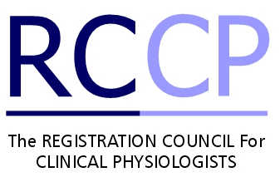
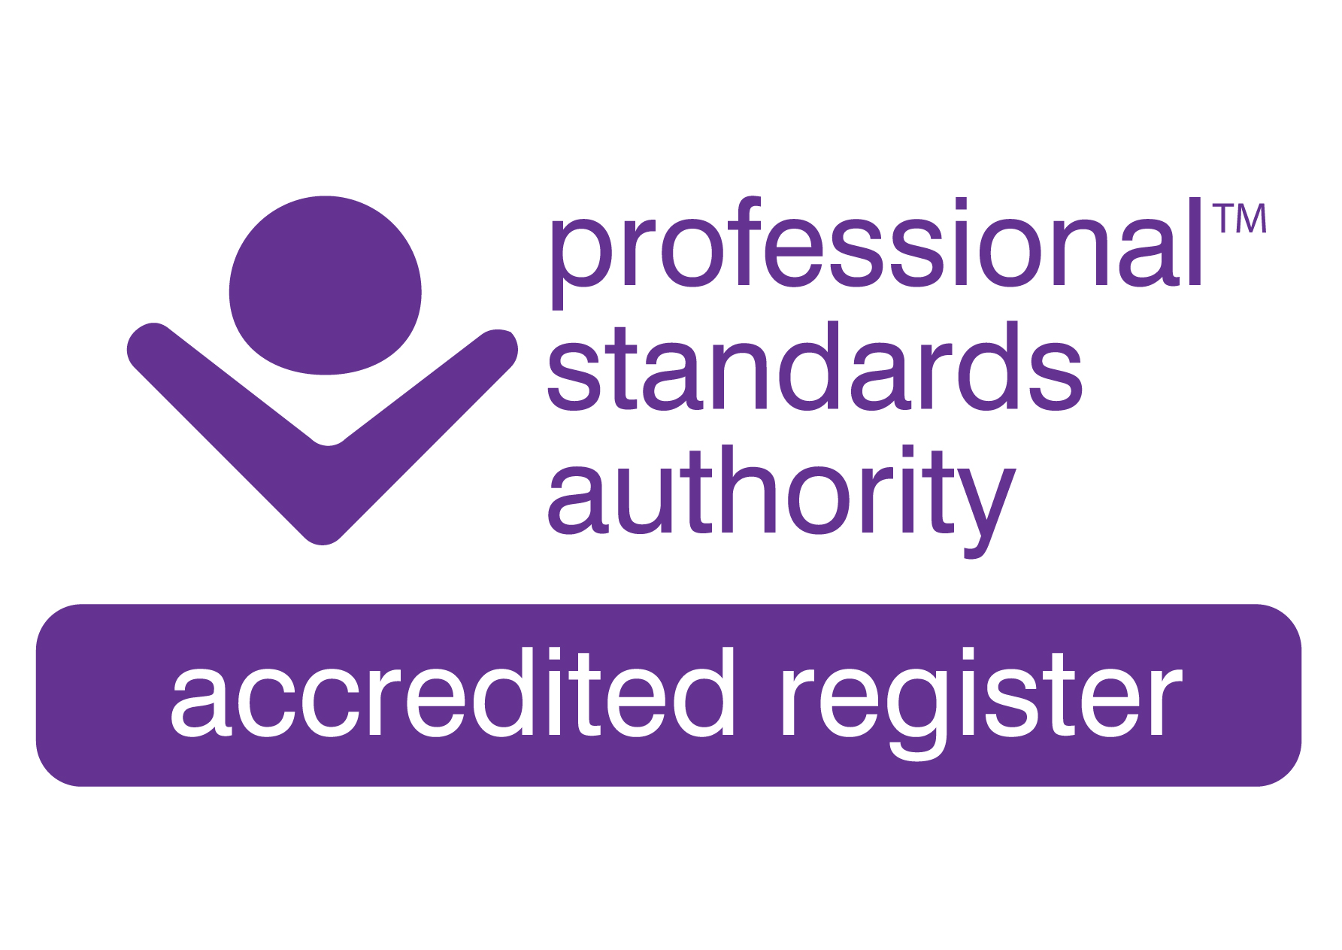
PRESS RELEASE
We are thrilled to announce that all business relating to The Registration Council for Clinical Physiologists (RCCP) has been transferred into the Academy for Healthcare Science (AHCS) with immediate effect.
This commences an exciting new chapter within clinical physiology where there is now one organisation running the two respective registers to develop greater clarity, understanding and improved patient safety.
Nothing will change in the immediate future; all existing staff are being retained and the RCCP annual renewal process for 2021/22 will continue as normal. Any registrant, public or Fitness to Practice queries should continue to be addressed to the respective organisation.
We would like to thank Paul Burgess, Chair of RCCP, who has stepped down from this role after 2 years of service to the organisation.
There will be announcements made over the coming months as new developments are launched within AHCS at what is an exciting time for our organisations.
We have also prepared a list of FAQ’s covering the changes which are being made. This will be published on our website in the next few weeks.
Any press enquiries can be addressed to: rccp@rccp.co.uk
NOTES: The AHCS is the overarching body for the whole of the Healthcare Science Profession, working to ensure that Healthcare Science is recognised and respected as one of the key Clinical Professions in the Health and Care system. Working alongside a diverse range of professional bodies and other stakeholders to bring together a wide range of scientific disciplines across the UK, the AHCS takes a proactive role in the identification of issues of concern to patients and the profession and supports the highest standards of patient care. It holds an Accredited Register, an equivalence process and supports the Certificate of Attainment and Certificate of Equivalence for the scientist training programme, AHCS has a long and key role in relation to voluntary and statutory regulation and registration.
• The RCCP campaigns for patient safety and holds an Accredited Register for the disciplines of Audiologists (including Educational Audiologists and Hearing Therapists), Cardiac Physiologists, Gastro-intestinal Physiologists, Neurophysiologists, Respiratory Physiologists and Sleep Physiologists.
01/06/2021

